Slide 1



Name | George Youssef Ward Issa
Code | NEXT81_ONL1_ERB8_M1d
Student ID | 21045178
ygeorge449@gmail.com

Slide 2
Agenda:
Situation Statement
Fishbone Diagram
SWOT Analysis
SMART Objectives
OKRs
Stakeholder Analysis & Power Grid
RACI Chart
Project Charter
Work Breakdown Structure “WBS”
Critical Path
Gantt Chart
Budget Management
Risk Management
Communication Management
Statement Of Work “SOW”
Project Plan

Slide 3
Initiating
0ahmed.m.allam0@gmail.com

Slide 4
The Situation Statement
“Beta T.B” is a company for delivering orders and products and one of the best companies in delivery and ensuring product safety and on-time delivery. However, in the recent period, its reputation has begun to decline due to the delay in delivering orders and the large number of orders in exchange for a smaller number of workforce.
The Problem
Beta “T.B” faces a sales decline due to the large number of orders, lack of workforce, failure to plan how to arrive on time, and many other reasons, this led to shipments and orders not arriving on time, or even not accepting delivery of some products due to lack of workforce.
The Effect
These issues led to customers being dissatisfied with the service and leaving and not using “Beta T.B” company and using other companies.
The Impact
The company was not the same as before, and the users became few, and former users started share their feedbacks about the company on social media and saying that it is miserable and its service is bad, which led to the company paying compensation in order to regain its reputation, but if the company does not solve this problem soon and quickly, it will be sad. It may be closed in the long term.

Slide 5
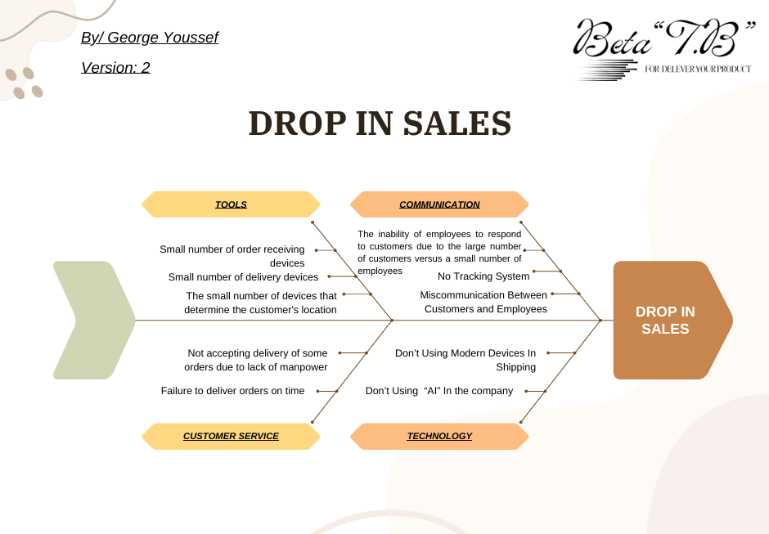

Slide 6
SWOT Analysis
STRENGTHS
1. A well-known company in the market and has many users.
2. The best company to ensure product safety in shipping.
3. It guarantees that the shipped product will arrive at the specified time and to the agreed upon address.
S
WEAKNESSES
1. Lack of manpower.| 2. Shipments did not arrive on time in the recent period.| 3. The presence of strong competing companies.
4. The company's reputation has deteriorated recently.| 5. The small number of company users.| 6. The company is unable to accept many orders due to the lack of workforce.
W

Slide 7
SWOT Analysis
OPPORTUNITIES
1. The company makes a strong comeback in the market before it is forgotten by its users.
2. It uses artificial intelligence to automatically respond to customers.
3. It uses faster devices so that it can deliver orders on time.
O
THREATS
1. The presence of competing companies occupying the place of “Beta T.B”.
2. Our customers use other companies.
3. The company may go bankrupt and close if this situation continues for a long time.
T

Slide 8
SMART Objectives
Goal one
SMART Goal one: “The non-sales rate will decrease by 70%, and this will be done by the company using “artificial intelligence” to respond to the customer in the event that there are no empty employee, and also through the company hiring more Employees to solve the problem of workforce shortage, and this will be done within 3 months, and Beta T.B. returns to the market again strongly and presents advertisements in order to become more familiar with the market.”

Slide 9
Goal one questions:
What makes this goal specific? Does it provide enough detail to avoid ambiguity? Response: The goal is specific because it shows what needs to be done: The non-sales rate will decrease by 70%, and this will be done by the company using “artificial intelligence” to respond to the customer in the event that there is no empty employee, and also through the company hiring more customers to solve the problem of workforce shortage, and Beta T.B. returns to the market again strongly and presents advertisements in order to become more familiar with the market.
What makes this goal measurable? Does it include metrics to gauge success? Response: The goal is measurable because it sets a clear metric: The rate of decrease equals 70% of non sales.
What makes this goal attainable? Is it realistic given available time and resources? Response: The goal is attainable because because after a month from project beginning the rate of the problem which is drop in sales will be decreased by 20% or more.
What makes this goal relevant? Does it support project or business objectives? Response: The goal is relevant there will be a timeline and this will be tracked by the project manager or its team and there will be milestones to help this goal be done and the end of the time which is “3” months.
What makes this goal time-bound? Does it include a timeline or deadline? Response: The goal is Time-Bound because it determines a deadline which after three (3) months should be the rate of the non-sales decreased by 70%.

Slide 10
Goal Two
SMART Goal Two: “Establishing a strong system for the company in distributing tasks to employees and using devices of delivering products that are larger in size, seeking to deliver the largest possible number from one employee and also faster in speed so that the company can meet the needs of the customers who use the company.” 80%” of the old devices in the company will be replaced. With the “largest and fastest” devices, within 6 months.”

Slide 11
Goal Two questions:
What makes this goal specific? Does it provide enough detail to avoid ambiguity? Response: The goal is specific because it stipulates the establishment of a strong system for the company in distributing tasks to employees and using modern delivering devices (Faster, Bigger). It also specified the amount of time that the company will take to implement these things and also the percentage of devices that will be replaced with new devices that will help solve the problem.
What makes this goal measurable? Does it include metrics to gauge success? Response: The goal is measurable because it sets a specific percentage, which expresses the percentage of devices in the company that will be replaced with new devices, which percentage is “80%.”
What makes this goal attainable? Is it realistic given available time and resources? Response: The goal is attainable because after 2 months of the project beginning 26% or more from the delivering devices will be changes by modern devices which will be faster and larger.
What makes this goal relevant? Does it support project or business objectives? Response: The goal is relevant because by establishing a strong system for the company in distributing tasks to employees and using modern and strong and fast and large devices of delivering products that will help to arrive the orders at time.
What makes this goal time-bound? Does it include a timeline or deadline? Response: The goal is time-bound because it sets a clear timeframe of 6 months for establishing a strong system for the company in distributing tasks to employees and using devices of delivering products that are larger in size, seeking to deliver the largest possible number from one employee and also faster in speed so that the company can meet the needs of the customers.

Slide 12
“Beta T.B” OKRs
 | O1 |  | Ensuring the safety of the shipped product until it reaches the customer.
 | KR1 |  | Decrease in the percentage by 85% of returns the orders that arrive damaged, scratched, or don’t do it’s performance well due error in delivery method and that within 70 days.
 | KR2 |  | Increasing feedback includes that the order arrived well and its quality remains good by 95% at least within 2 months.
 | KR3 |  | An increase in the number of emails thanking the company for maintaining the quality of the product during shipping and not causing damage to it.
O2 |  | The company makes sure that the service provided is the service required by the customer.
KR1 |  | Get 97% of feedback that the customers are satisfied from the company’s service within 120 days.
KR2 |  | An increase in customers’ use of the Beta.TB service by 20% within 4 months.
KR3 |  | The company has obtained its previous reputation, which guarantees that the company provides the best shipping service and that through 8 months.

Slide 13
 | O3 |  | The company ensures that the shipped order arrives on time with the customer.
 | KR1 |  | Reduced order delays by 90% within 3 months.
 | KR2 |  | Achieve 85% of order at the time and don't be late within 2 months.
 | KR3 |  | 87% of the feedback of the customers after the orders arrive include that their order arrived at time and that through 50 days.
O4 |  | Arrive the order that was booked from a customer to its address not another.
KR1 |  | Reduce the percentage of arriving order by wrong to another address by 86% within 4 months.
KR2 |  | Reduce the number of customer complaints that the requested order did not arrive, but someone else did by 80% within 90 days.
KR3 |  | Ensuring that all orders are arrived at the right address.

Slide 14
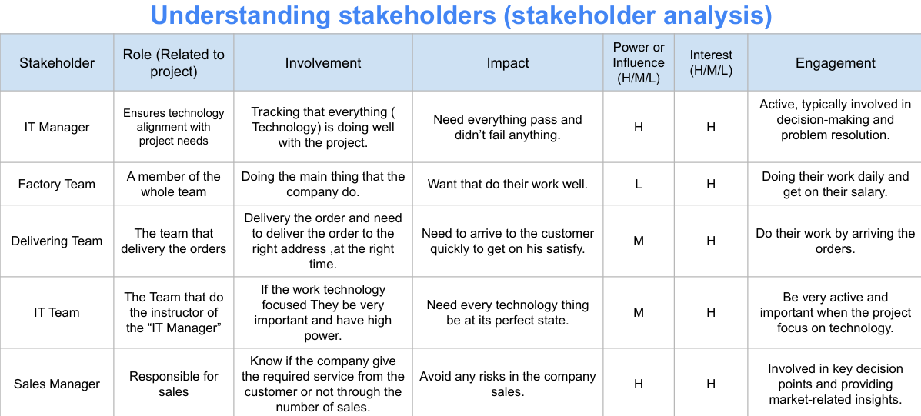
Active, Especially during technology tasks

Slide 15
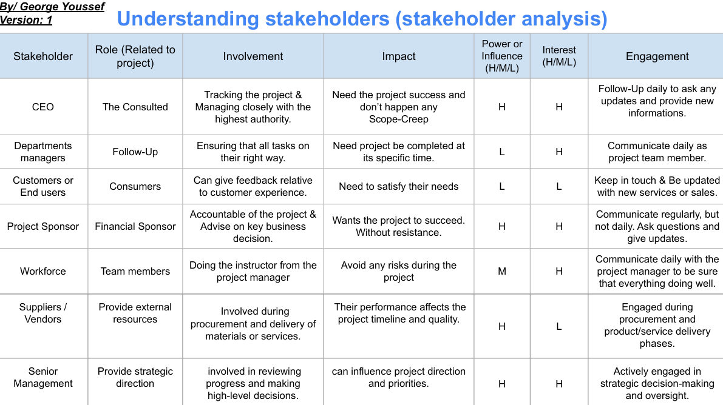

Slide 16
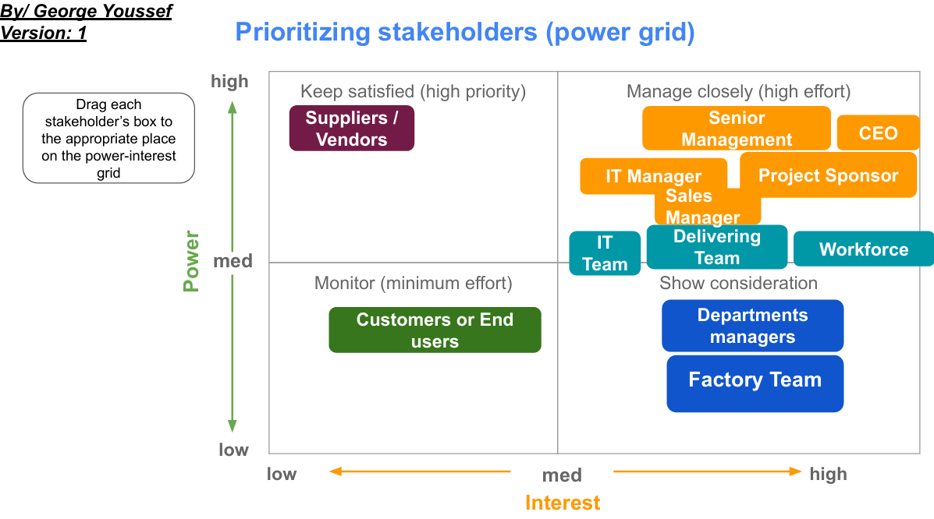

Slide 17
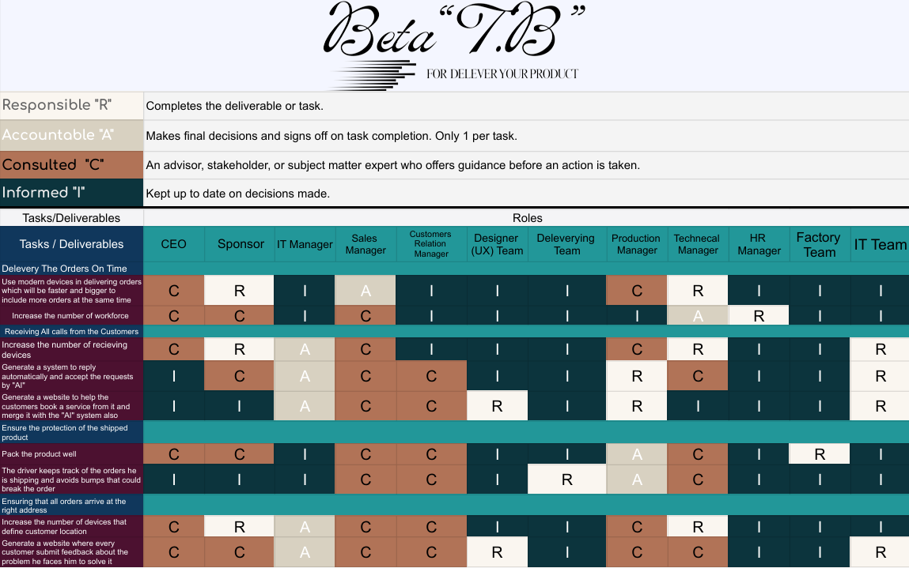
RACI Chart

Slide 18
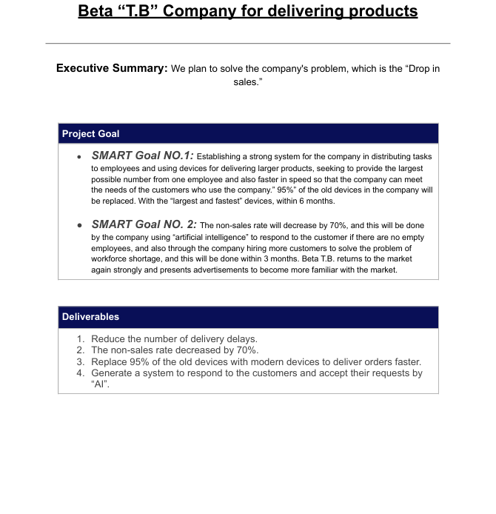
Project Charter

Slide 19
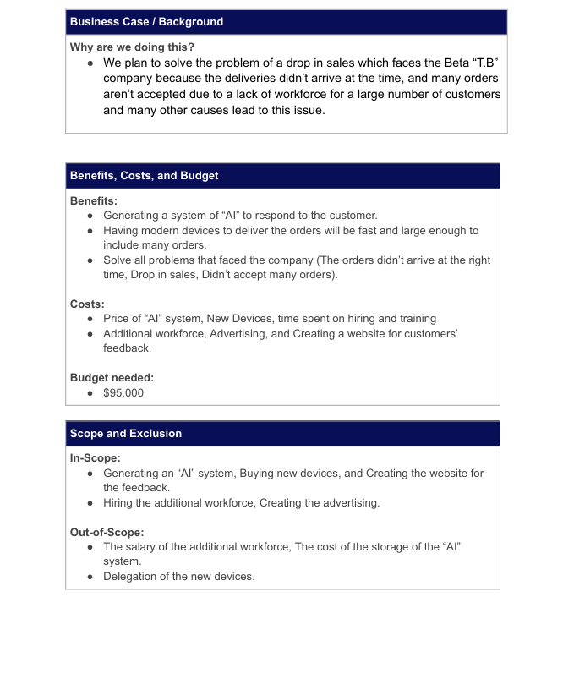

Slide 20
Project Team
Project Sponsor: Director of Operations Project Lead: Project Manager (Me) Project Team: IT Team, Factory Team, Delivery Team, Workforce, Training Manager, Designer Team, IT Manager. Additional Stakeholders: Suppliers / Vendors, Sales Manager, Senior Management, Customers or End users, and department managers
Measuring Success
What is acceptable: The company sales increased by 35% within 3 months. The 40% of the customers’ feedback includes sentences represent on satisfying with the company's service within the 4 months.

Slide 21
Planning

Slide 22
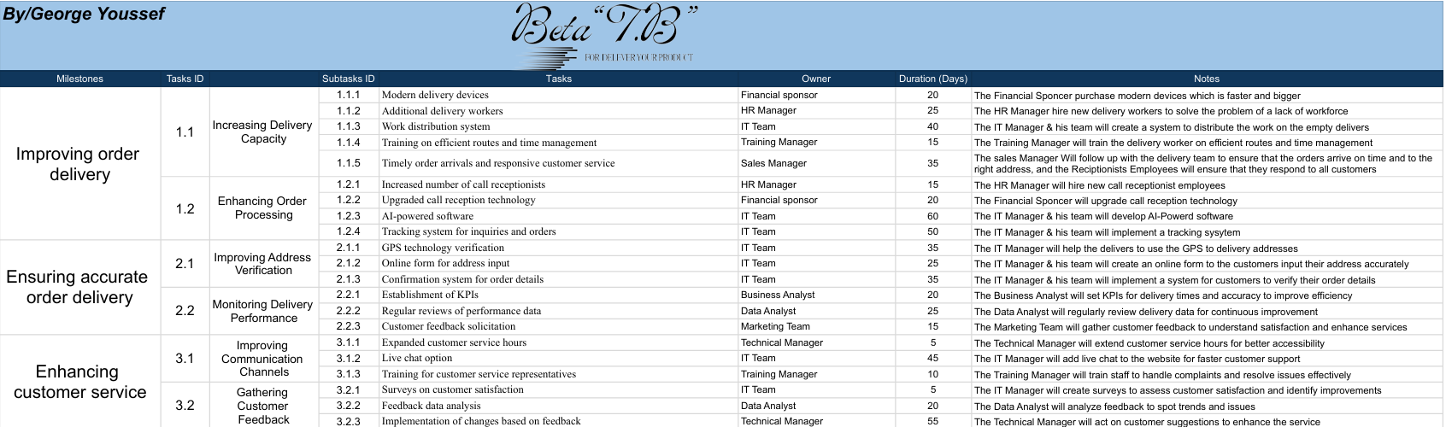
Work Breakdown Structure “WBS”
https://www.canva.com/design/DAGT_5HsnF0/JscM7vIHT3z1z4AJJmioqA/edit
Interest

Slide 23
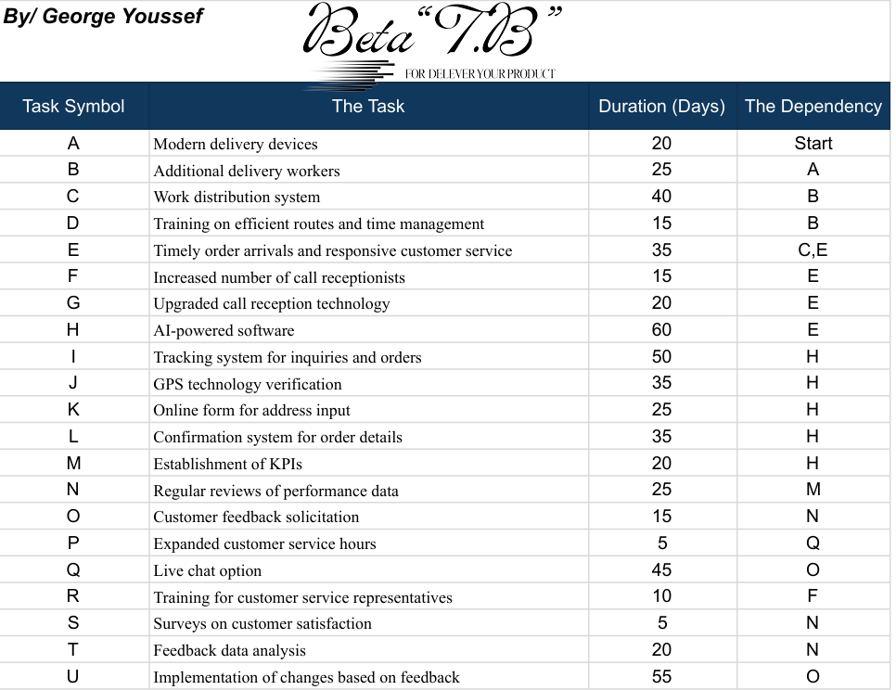
Network Diagram

Slide 24
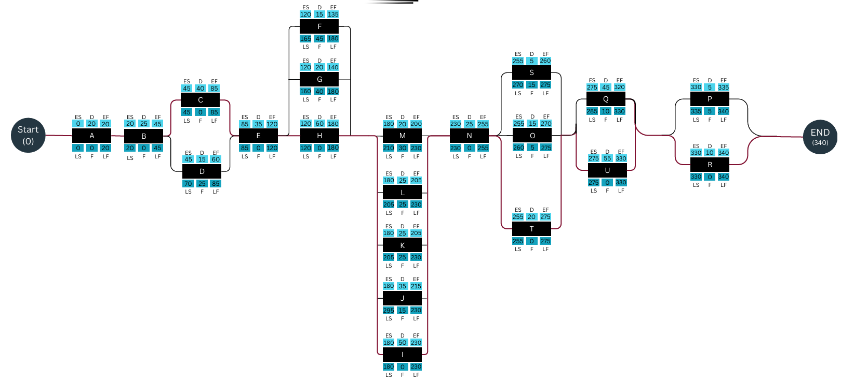
Critical Path

Slide 25
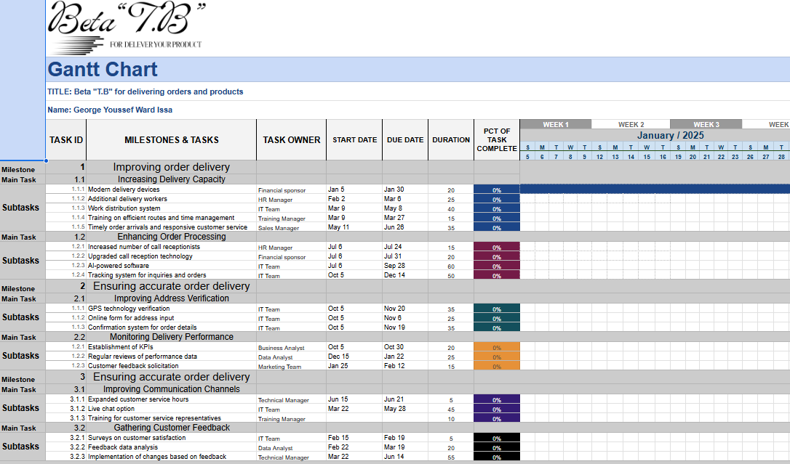
Gantt Chart
https://docs.google.com/spreadsheets/d/1SX_NL2xzu7K7r9Q2Y_euOmn_2_1pR48B/edit?usp=sharing&ouid=115732853454613505689&rtpof=true&sd=true

Slide 26
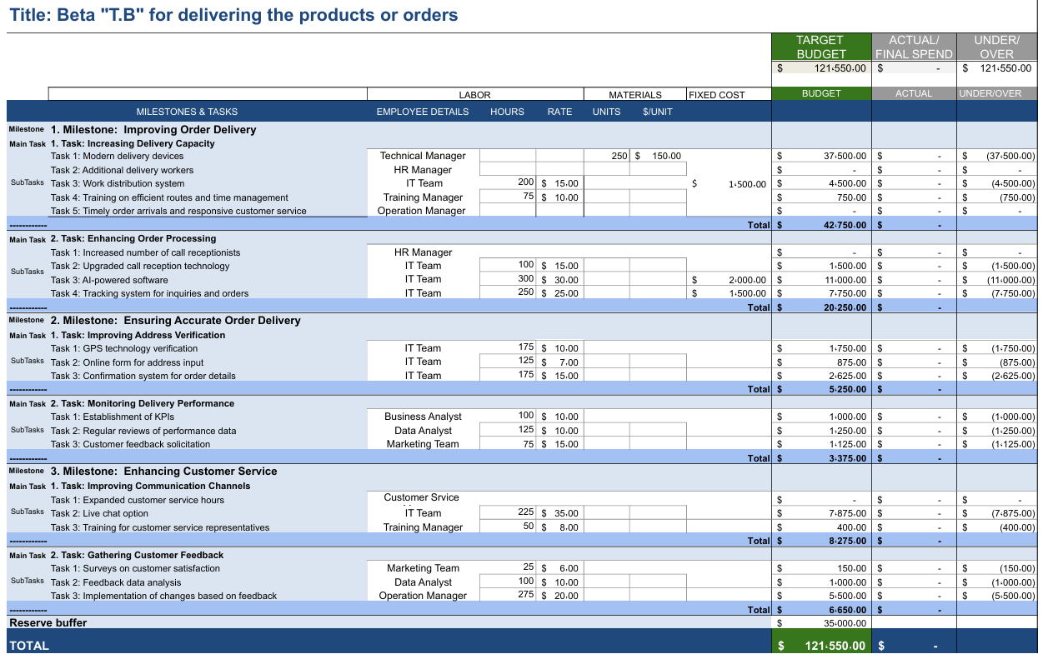
Budget Management
https://docs.google.com/spreadsheets/d/1oPR8U_lJLRuhdRVVThof04hjbBcr-Oxc/edit?usp=sharing&ouid=115732853454613505689&rtpof=true&sd=true

Slide 27
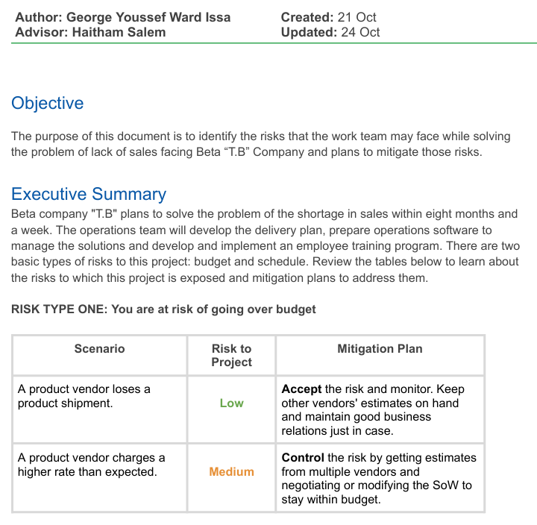
Risk Management

Slide 28
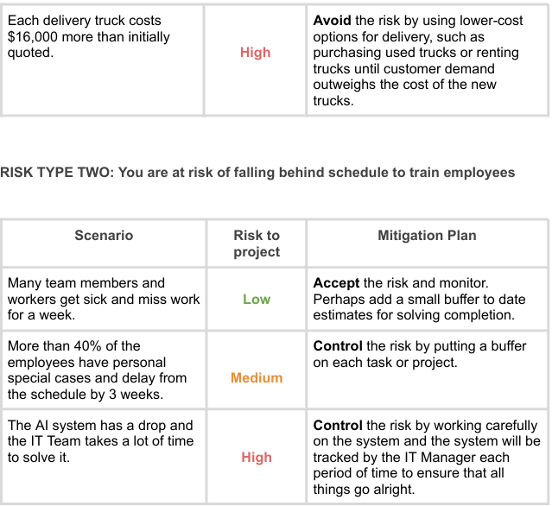

Slide 29
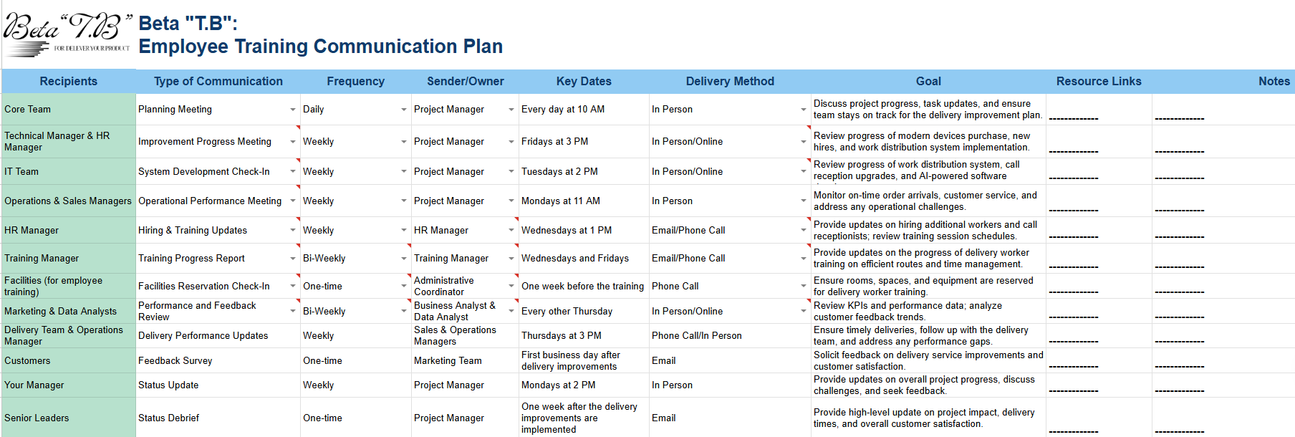
Communication Plan

Slide 30
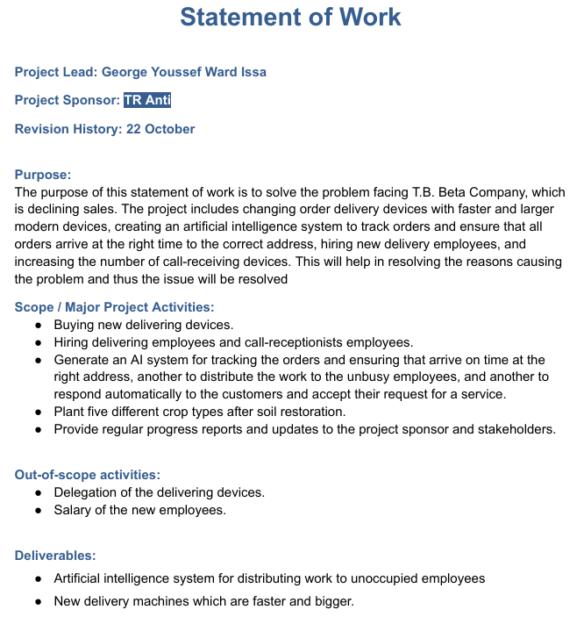
Statement Of Work “SOW”

Slide 31
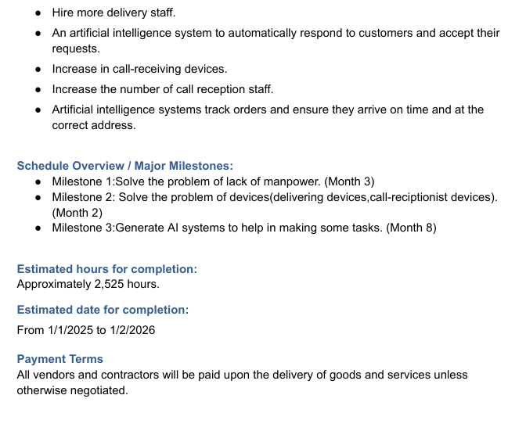

Slide 32
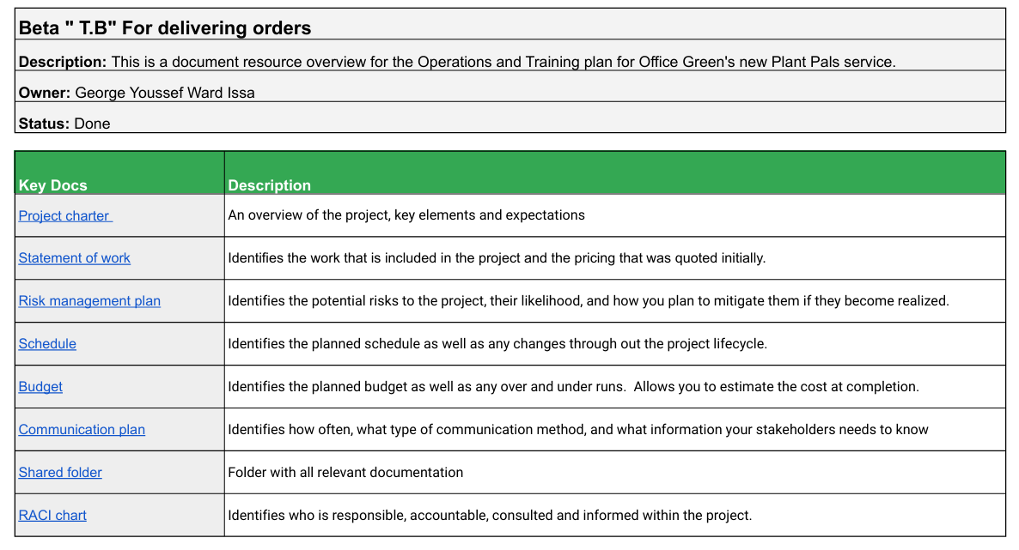
Project Plan
Key Docs Description

Slide 33
Questions ?!

Slide 34
Thanks !
George Youssef Ward Issa
ygeorge449@gmail.com
+201096992013

